Slide 2


Cold email marketing templates for sales teams
  Get our proven cold email templates (for sales teams) to nail your outreach and close deals. Plus tips to write a cold email & subject lines.
  There is one catch however is that you can’t just put your name and company and press send you will need to customize this to fit with your company goals and your prosects goals.
Talk to us today to see how we can help
Please right click on button above > Link > Open link to view the examples

Slide 3

What is a Cold Email Template?
A cold email is a message that is sent to a targeted contact that has never heard from you before.
Sales teams can use cold email outreach to target new customers/prospects to entice them into your sales funnels.
If you get them right they can be incredibly effective. Get them wrong and they can look like spam.
At Pink Elephant Media we have complied a list of tried and tested emails to help you with your cold outreach. These emails are designed to be a strategic targeted approach to specific companies likely to be interested in your company as their solution.
This is why cold email outreach is so crucial to driving sales. Using a template does not just save your team time, it will improve open rates by ensuring every email includes critical elements for success like focusing on the benefits of your product or service.

Slide 4

INTERACTIVE: Please type in the boxes to complete…
The “Introductory” Email.
As the title suggests this email is sent to introduce yourself and your products or services. Although it maybe tempting to sell you want to try to resist the urge, even under the premise of a soft sell.
TO
CC
Subject:
B I U A AA
A A
Hey [insert name],
I hope that this email finds you well. I know you are probably flat out busy, so I won’t take up a lot of your time. The purpose of this email is to introduce myself as I was wanting to ask your opinion on something we are working on. We are doing a bit of research for our business on if [insert common pain point associated with this industry] is an issue in your line of work. If it is it would be great to have a chat about it if you could spare some of your time. My diary link is [insert diary link].
My company, [insert company name] specialises in the [insert what you do]. I am a big supporter of your company and keep close tabs on all your latest news so would really value your opinion.
Thank you for taking the time to read my email, if you don’t have time no worries hopefully our paths will cross in the not too distant future, and if you would like to view the results of our findings let us know and I will put you on our list for the results of our research
All the best,
[insert your name]
This is a relationship based email. You are not going in for the kill but simply to introduce yourself and ask for their knowledge
The idea of this email is to entice them into a call to discuss their pain points that will allow you to show yourself as the solution.

Slide 5
INTERACTIVE: Please type in the boxes to complete…
The “Hard sell” Email.
This type of email can go one of two ways. You can catch the right person at the right time by intriguing them enough to set up a meeting or ask for more information or you can just put them off straight away.
TO
CC
Subject:
B I U A AA
A A
Hey [insert name],
Are you looking for a way to [insert their goal] through your business? With [insert your solution] we have the skills and knowledge to take your business to the next level.
I have enclosed a recent case study to show you how we took a business in your industry to that next level and how we could do that for you.
If you are interested in exploring this further please do get in touch or book a meeting via our live diary link [insert link] so we can discuss this further.
All the best
[insert your name]

Slide 6
INTERACTIVE: Please type in the boxes to complete…
The “Soft sell” Email.
If a hard sell feels too much for you then a softer approach might be more up your street.
TO
CC
Subject:
B I U A AA
A A
Hey [insert name],
As the [insert job title] of [insert company name], it is my job to reach out to people in your industry who can provide us with…
It is not always easy to find experienced professionals who are happy to give up a few moments of their time to help but I am hoping you may be able to.
Our primary service consists of [insert services] which I am sure you are familiar with in your position
Our goal as a company is to help deliver the services that clients in your industry really need. We are conducting our research [insert link to the research] where we have identified top pain points within your industry and have focused on a real solution. We would really like the opportunity to get your feedback on our research.
All the best
[insert your name]

Slide 7
INTERACTIVE: Please type in the boxes to complete…
The Blog Post.
This is one of the more unusual ones but is highly effective. This can be used via LinkedIn Outreach (see our training courses) directly to your target audience or via your email marketing or contact list. No longer will you just be writing articles for the sake of writing an article you will finally be able to get the right eyeballs on it by sending it directly to your target audience.
TO
CC
Subject:
B I U A AA
A A
Hey [insert name],
Upon publishing our most recent blog post, [TITLE HERE],” I immediately thought of you and your company.
The blog post [insert what the blog post tells the client] and can be found on our website here [insert link]
I would love to hear your thoughts on the post, including any feedback we could use in the future to provide our audience with better content.
Of course, don’t hesitate to share some of your favorite blog posts. I am always interested in reading what other industry professionals have to say if iwe connect on social media [insert LinkedIn handle] then I would be happy to share.
Thank you for your time.
All the best
[insert your name]

Slide 8
INTERACTIVE: Please type in the boxes to complete…
The “I am in your area” email.
You would never show up unannounced but if you have been trying to get to see a prospect for some time this is a great way to break the ice and get that important meeting booked in
TO
CC
Subject:
B I U A AA
A A
Hey [insert name],
I know you are busy, so I’ll be quick. I have several clients in your local area and will be stopping by to visit some of them next week.
If you have a few moments, I would love to stop by and drop off some information regarding our products and services. My schedule is flexible, so whatever works for you will most likely work for me.
You can be rest assured that I will be “in and out.” I only want to stop by for a few minutes, introduce myself and leave some resources behind.
Do you have any time next week? Maybe Wednesday or Thursday between 1 and 2 pm? Let me know your thoughts!
Thanks for your time.
All the best
[insert your name]

Slide 9
INTERACTIVE: Please type in the boxes to complete…
The “Connections in common” email.
Name dropping can be a killer strategy but some people really don’t like to do it. For cold emails it is a great strategy to try
TO
CC
Subject:
B I U A AA
A A
Hey [insert name],
I am writing you this note, as I recently learned that you are business acquaintances with a close friend of mine, [insert name]
In a recent conversation with [insert name of associated contact], he/she mentioned that you might be interested in a new service we are rolling out.
Do you happen to have a few minutes next week to jump on a phone call or meet over teams? I would appreciate the opportunity to share more about the service, while also getting to know each other a bit more.
I hope you are okay with me reaching out. Once with [insert name of associated contact], explained your background in greater detail, I immediately realised you would be the perfect person to speak with.
Thanks for your time I hope to see you soon.
All the best
[insert your name]

Slide 10
INTERACTIVE: Please type in the boxes to complete…
The “Free Help “ email.
This is somewhere in between a soft and hard sell approach. It is obvious that you want to provide free advice in order to sell your services but as long as you say it is free they won’t feel too pressurised. If you have a clinic that offers free advice each month to a few people then this could also look time critical.
Note you could here use a diary link or have a book a call page on your website to increase traffic.
TO
CC
Subject:
B I U A AA
A A
Hey [insert name],
As an expert in [insert what you do], I take great pride in helping clients [insert what pain point you help solve] . Please see all our google reviews for free advice given.
I was reviewing your company the other day and believe we can help you [insert the result of what a client would want to achieve after working with you].
Do you have time to jump on a call to discuss some of these basic tactics or would you like me to send you a video report on my findings? Either way, it is free of cost. I simply want to talk more, provide some advice and learn more about your business and your goals and if you were looking for a company to work with in the future you may consider us. We believe in delivering value up front so If this sounds good to you, shoot me a quick reply as to your preference of a video overview or booking a meeting.
Thanks for your time
[insert your name]

Slide 11
INTERACTIVE: Please type in the boxes to complete…
The “My boss asked me “ email.
TO
CC
Subject:
B I U A AA
A A
Hey [insert name],
My {boss, CEO, CFO etc] asked me to reach out to you.
Our company [Insert company name], is specifically designed to help [insert the main pain point you solve for this client].
Our customers enjoy [insert core benefits or value proposition]
I would love to chat with you if possible to discuss how we can help you and show you some of the results we have achieved for other clients.
[insert your name]
The “Provide value“ email.
TO
CC
Subject:
B I U A AA
A A
Hey [insert name],
My name is [insert first name], [position] at [company]. We recently published a post [insert title of post with link]. In it we [detail what the blog article contains and the main key take away points]
Due to your expertise in [insert industry or topic], we included [how you referenced them in the blog post etc]. Thanks so much for sharing your knowledge, it made this post much stronger.
I would love to hear your thoughts or if you any additional comments you want to add.
[insert your name]

Slide 12
INTERACTIVE: Please type in the boxes to complete…
The “I think we might have met before“ email.
TO
CC
Subject:
B I U A AA
A A
Hey [insert name],
I hope this note finds you well. I am not sure if you remember me, but we met a few months back at the [insert when you met]. I enjoyed our conversation and It has stayed with me and I have even implemented some of the strategies you discussed with me.
We are in the process of ramping up our marketing efforts and I recall you mentioning the need for a service similar to the one we provide. Is this still the case? Have you found what you are looking for?
Even if we don’t have the opportunity to work together, I hope to hear back. I truly value the advice you provided me.
Thanks again for taking the time with me.
[Insert your name]

Slide 13
INTERACTIVE: Please type in the boxes to complete…
The “Authority building“ email.
TO
CC
Subject:
B I U A AA
A A
Hey [insert name],
[Main pain point] is challenging. [Mention additional prospects pain points]
I totally get it – and I think we might have the solution.
[your business] helps [target audience] [benefit you deliver]. We’ve helped companies like yours reach [insert a guess at this prospects likely goal]. I have attached a case study to show what we have done for another client in your field.
It would be great to connect for 15 minutes and discuss how we can help [insert company] team achieve your company goals. If you are not impressed then no hard feelings but I am pretty sure we can make a good first impression!
[Link to schedule call]
Thanks for your time
[insert your name]

Slide 14
INTERACTIVE: Please type in the boxes to complete…
The “research“ email.
TO
CC
Subject:
B I U A AA
A A
Hey [insert name],
While researching [company name], I came across your profile – I was so impressed by how passionate you've been the past [number of years they've worked at the company, look it up on their LinkedIn profile] years to help scale the [department] team, while also being a go-to advisor for your growing customers.
However, I imagine you may be struggling with [address pain point your solution solves]. I'm curious - are any customer accounts at risk that would benefit from [what you offer]?
[Recognisable similarity competitor or exact competitor], needed a way to [what you offer]. Since leveraging [your company name], their [major benefit]. As a result, their customers experienced [business impact].
Does it make sense to explore ways we can help your team as well?
[insert your name]
The “land a meeting“ email.
TO
CC
Subject:
B I U A AA
A A
Hey [insert name],
I am writing in hopes of finding the appropriate person who handles [DEPARTMENT I.E. MEDIA]? I also wrote to [PERSON X, PERSON Y, AND PERSON Z] in that pursuit. If it makes sense to talk, let me know how your calendar looks.
If you are the appropriate person to speak with, what does your calendar look like? If not, who do you recommend I talk to?
[insert your name]

Slide 15
INTERACTIVE: Please type in the boxes to complete…
The “follow up“ email.
This is one we use here and it works nearly everytime! We borrowed this one off hubspot and made our own version but it is our favorite winner
TO
CC
Subject:
B I U A AA
A A
Hey [insert name],
Hope you are well. I’ve thought I would reach out to see if you still wanted to talk about your plans as we have not heard back from you which tells me one of three things:
1) You’re all set with your plans and I should stop bothering you.
2)You’re still interested but haven’t had the time to get back to me yet.
3) You’ve fallen and can’t get up and in that case let me know and I’ll call someone to help you ….
Please let me know which one as I’m starting to worry!
All jokes aside, If you have decided to go in a different direction, that is fine, just let us know and we can close your file, alternatively if you wanted to have just an initial discussion to get things underway or to have something to think about I would be happy to find a time that suits you.
All the best,
[Insert your name]

Slide 16
INTERACTIVE: Please type in the boxes to complete…
The “General follow up“ email.
This is one we use here and it works nearly everytime! We borrowed this one off hubspot and made our own version but it is our favorite winner
TO
CC
Subject:
B I U A AA
A A
Hey [insert name],
Hope you’re having a good day!
I wanted to quickly follow up on [Topic in Question]. Last we spoke, I believe [Describe Follow-Up Actions].
With that said, would you be able to [Outline Requested Follow-Up Actions]?
Let me know if you have any questions for me here.
Thank you,
[Insert Name]
TO
CC
Subject:
B I U A AA
A A
Hey [insert name],
Thanks for sharing more information about your [insert what you talked about]
It sounds like you will have some more questions for me about how we can solve [PROSPECT’S PROBLEM], and I need a bit more info from you to make sure we can hit your timeline, budget, and objectives for the project.
I am happy to move as quickly or slowly as you need. What would you like to do next?
[Insert Name]

Slide 17
INTERACTIVE: Please type in the boxes to complete…
Don’t forget the subject Line
The subject line is the most important part of your email as it does not matter how good the content of your email is if it does not resonate with your target audience. Here are some top tips and examples of great subject lines for your email.
As a general rule of thumb, the best subject lines are descriptive, short and provide a reason to read the email.
Personalization. This should include the recipient’s first or last name, and a city name if possible.
Keep it compact. Most people scan subject lines, immediately making a decision on whether to open, pass or delete. Subject lines of 50 characters or less have a higher open rate.
Test, test and test again. Create multiple subject lines and test each one. By tracking the results, you can see what works best for your audience.
All in all, your first goal is for a large majority of recipients to open your email.
From there, you want your email to generate a positive response. If you don’t take the time to test subject lines, you are missing out on an opportunity to reach more people

Slide 18

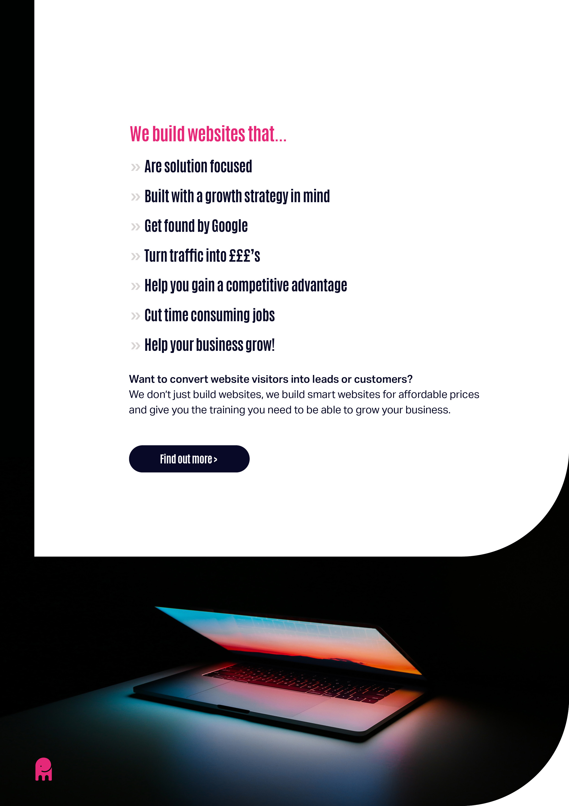
Additional Tips for Great Homepage Content
Now that you have a framework in mind for your homepage, here are a few final tips:
Make sure your page and website design is bold and easy to digest. Use of strong branding will help with this. If you have not got any strong brand guidelines and guides get in touch with us today to find out how we can help you produce a strong home page.
Include cohesive branding throughout the page.
Set up a useful information flow so that people aren't confused about where to look.
Make it easy to scan quickly.
Ensure your content is readable and speaks to a single person in a conversational tone.
The Final Step
If you’ve followed our advice so far, your homepage should be ready to convert visitors into customers; however, you can’t convert visitors into customers without having visitors in the first place.
You can get more visitors from Google by making sure that your homepage is meeting keyword optimisation best practices. If you are one of our clients you will have been provided with al the keywords needed, however if you are not and you want to understand how keywords work then we have an SEO course that will take you from beginner to expert in a few easy steps. Our training will walk you through all the places you’ll need to add keywords to your homepage for proper optimization.

Slide 19



