Slide 1
Marketing Plan Template

Slide 2
How to Use This Template
This template is designed to be a starting off point for your company’s marketing plan. It includes customised sections for:
Business Summary Business Initiatives Target Market Market Strategy Budget
Marketing Channels Marketing Technology
Once you’re ready to begin, delete pages 1–3 and start filling out your info below. There will be instructions and sample text, as well as prompts in [brackets] for you to complete as guided.
Remember, you should add/edit/delete any copy or sections as you see fit.

Slide 3
Creating a sales and marketing strategy for your small business can be daunting.
It’s a strategic plan that includes tactics and tools that are precisely targeted to the audience that you’re trying to attract.
The Personalized Growth Planner framework has proven ideas and innovative strategies designed to help you get more customers, grow your sales and save time.
This planner contains everything you need to keep your small business on track for the next week, month and year. You can use this planner to record ideas and insights about the biggest opportunities you see in your marketing and sales strategies.
Yes, it will be hard work. And yes, Pink Elephant Media will be right here with you as you do it. Let’s create a sales and marketing strategy together, one step at a time
The personalized growth planner framework will help you get more leads, grow your sales and save time.

Slide 4
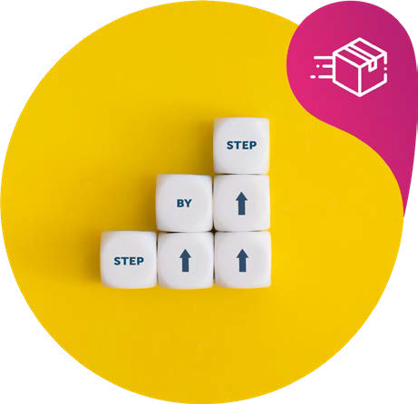
Lifecycle Marketing
Collect Leads
Collecting leads is the first stage of Lifecycle Marketing and includes strategically identifying your audience, creating content that appeals to your target customer, and systematically capturing their information.
Target Attract Capture
Convert Clients
Converting clients is the second stage of Lifecycle Marketing that bridges the transition from a promising lead to a loyal customer
Engage Offer Close
Create Raving Fans
Creating fans is the last and arguably most key component of Lifecycle Marketing. Depending on the level of execution in this specific area, your customers become more than a transaction; they are your advocates by becoming repeat customers, offering referrals and leaving you positive reviews.
Deliver
Impress
Multiply

Slide 5
Markting Plan
[Company Name]
YOUR LOGO HERE
[Company Web Address]
Version 0.0.0 [Date]

Slide 6
YOUR LOGO HERE
Table of Contents
Executive summary
#
Business Summary
#
Business Information
#
Key Marketing Goals
#
Competitor Analysis
#
Swot Analysis
#
Business Initiatives
#
Target Market
#
Buyer Personas
#
Completive Analysis
#
Customer Journey Map
#
Branding
#
Marketing Strategy
#
Routes to Market
#
Marketing Technology
#
Budget
#
KPI’S
#

Slide 7
Executive Summary
Here, provide a brief overview of all the key points in your plan. It should give you and others a good understanding of what you’re going to do and why, without going into too much detail.

Slide 8
Business Summary
Our Company,
[Company name] is a company headquartered in [location of HQ] with offices in [state office locations]. The company’s mission is to [mission statement].
Our Market Leaders are
[Marketing Leader 1] | [Marketing Leader 1] is [company name]’s [job title of Marketing Leader 1]. They will [brief job description of Marketing Leader 1].
[Marketing Leader 2] | [Marketing Leader 2] is [company name]’s [job title of Marketing Leader 2]. They will [brief job description of Marketing Leader 2].
[Marketing Leader 3] | [Marketing Leader 3] is [company name]’s [job title of Marketing Leader 3]. They will [brief job description of Marketing Leader 3].
Look to include some key features that makes your marketing leads stand out, such as experience, specific expertise. You could also include some headshots or a link to their LinkedIn profile
PRO TIP

Slide 9
Business Information
In order to give your plan context, you should provide a background of the business. Be sure to include:
Who you are and what your business does.
A summary of why your business exists.
Your mission and vision statements.
Your wider business (not marketing) goals

Slide 10
Key Marketing Goals
To start we have to begin with the end in mind and have a clear understanding of what you want your destination to be. Be as specific as you can, explain each one and why you have set it and why they align to your business objectives.
Typical goals could include.
Financial - driving more revenue, cutting costs to raise profitability and sustain cash flow, and setting new financial targets for future growth.
Growth - new markets, launching new products, increasing your customer base, or raising brand recognition, it’s important to establish a realistic number of goals, actionable tasks, and a team to complete those growth goals.
Customer Goals - Improving relationships with your target audience doesn’t just solve problems for individual customers. Enhanced customer service also helps your company develop respect among all stakeholders, which promotes additional business growth.
Here, provide a brief overview of all the key points in your plan. It should give you and others a good understanding of what you’re going to do and why, without going into too much detail.
Increase productivity

Slide 11
Competitor Analysis
In this section should contain the key findings of the competitor research you’ve conducted. To be able to conduct a full fact finding you can take our course Beat your competitors on line which takes you through how to look at what marketing your competitors are doing to their top landing pages. Once you have viewed this course you can fill in the following:
The channels your competitors are successfully using
The sources they’re getting their traffic from
The top products and pages on their sites
The kinds of ads they’re running
Pink Elephant Media have a training course on how to beat your competitors on line by spying on their digital foot print. Take the course here.
PRO TIP

Slide 12
SWOT Analysis
Strengths | Weaknesses
What we’re good at? What’s working? What our customers like about us? | What do we need to work harder at? Where we are not as strong as our rivals? What can we do to improve efficiencies internally?
What problem do we solve for our customers? | What would our clients say we are not as good as they would like us to be?
Any external factors at play?
Opportunities | Threats
What could we provide that clients want? What our competitors supplying that we could do better than them? Could you team up with other companies to create a better offer? | What could prevent us from hitting our goals? What threats from our competitors (pre- tend you are them trying to steel your clients). Who or what could take your customers?

Slide 13
Company Goals
[Company name] goal is to [overarching company goal]. To help the business do that, our marketing team will pursue the following initiatives in [current year].
Initiative 1
Description | [Example: Over the next 12 months, we’ll work on building a blog property that becomes a go-to resource for our customers’ burning questions – and our number-one source of leads month over month.]
Goal of initiative | [Example: To increase our website’s rank on Google and create critical top-of-the- funnel marketing content that helps our sales team start more conversations with prospects.]
Metrics to measure success | [Example: 50,000 organic page views per month / 10 content downloads per month]

Slide 14
Company Goals cont.
Initiative 2
Description | [Example: Over the next 12 months, we’ll work on building a blog property that becomes a go-to resource for our customers’ burning questions – and our number-one source of leads month over month.]
Goal of initiative | [Example: To increase our website’s rank on Google and create critical top-of-the- funnel marketing content that helps our sales team start more conversations with prospects.]
Metrics to measure success | [Example: 50,000 organic page views per month / 10 content downloads per month]
Initiative 3
Description | [Example: Over the next 12 months, we’ll work on building a blog property that becomes a go-to resource for our customers’ burning questions – and our number-one source of leads month over month.]
Goal of initiative | [Example: To increase our website’s rank on Google and create critical top-of-the- funnel marketing content that helps our sales team start more conversations with prospects.]
Metrics to measure success | [Example: 50,000 organic page views per month / 10 content downloads per month]

Slide 15
Identify Your Target Audience
As an entrepreneur, you have big dreams. You want the entire world to know your products and services are available to everyone.
It can be easy to spend huge sums of money trying to attract the world to your products and services, only to find that you’ve overspent your budget and you don’t have any new customers.
It’s hard to get noticed in this clutter-filled world, but attempting to reach everybody with your product or service is not only inefficient, it’s also very expensive. That’s why it’s important to narrowly define your target customer and meet them where they are.
These pages below will help you identify where you can find your perfect audience, how to attract them and then how to nurture them.
Who are my ideal customers? (Use demographics such as age, annual income and education level. Use psychographic information such as behaviours, hobbies and values.)
What are their pain points? (Efficiency, ease of use, time, etc.)

Slide 16
Identify Your Target Audience
What are their most common objections to doing business with me? (Cost, time, etc.)
Who is not my target customer?
Key Actions in the next 30 days
Think about the ways you can counter objections and provide value to potential targeted customers.

Slide 17
Target Market
Here, you should provide a high-level overview of your target market. How big is it? What opportunities or restrictions exist? How competitive is it? You can draw on a wide range of sources (be sure to list them) and include visuals, tables, and diagrams to support your narrative.
In [current year], we’re targeting the following industries where we’ll sell our product and reach out to customers:
Industry 1 | This includes [sub-industries where your business might target more specific segments of your audience]. [Example: Industry 1: Food and Beverage. This includes bar & grills, breweries, steakhouses, etc.]
Industry 2 | This includes [sub-industries where your business might target more specific segments of your audience]. [Example: Industry 1: Food and Beverage. This includes bar & grills, breweries, steakhouses, etc.]

Slide 18
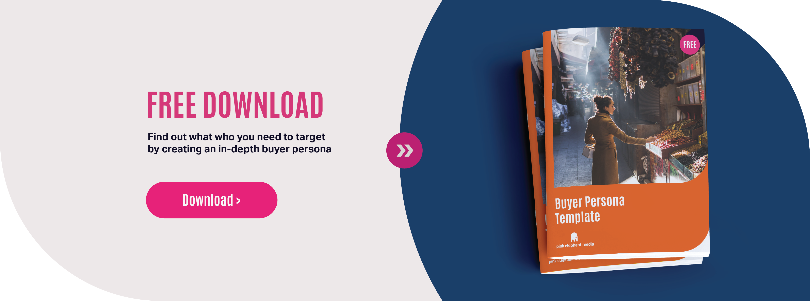
Buyer Personas
Within the target market(s), we’ve identified the following buyer personas to represent our ideal customers:
Buying Persona 1
This includes [sub-industries where your business might target more specific segments of your audience]. [Example: Industry 1: Food and Beverage. This includes bar & grills, breweries, steakhouses, etc.]
Buying Persona 2
This includes [sub-industries where your business might target more specific segments of your audience]. [Example: Industry 1: Food and Beverage. This includes bar & grills, breweries, steakhouses, etc.]
If you have yet to develop your buyer persona you can use these free templates to help you. These will assist you with a visual representation
PRO TIP

Slide 19
Competitive Analysis
We expect to compete with the following industries within our target markets
Company 1
Products/ Services we expect to compete with | [This competitor’s product/service, what it does, and what it might do better than yours]
Other ways we compete with them | [This could be other products and services, how they are marketing themselves eg LinkedIn Lead Generation etc.]
Company 2
Products/ Services we expect to compete with | [This competitor’s product/service, what it does, and what it might do better than yours]
Other ways we compete with them | [This could be other products and services, how they are marketing themselves eg LinkedIn Lead Generation etc.]

Slide 20
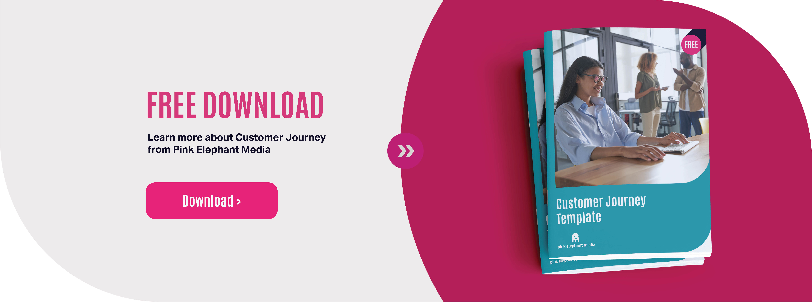
Customer Journey Map
Here, you should lay out the journey that your or your competitors’ customers take from first contact to making a purchase or sale including after sales process and how you can nurture that client. Explore the kinds of sources and channels that your target leads typically come from and analyse the steps they take at each stage of the funnel all the way to conversion.
How to capture that lead/sale through to completion of the sale
Unique selling point you can offer After sales process
Include how you intend on tracking these funnels
If you have yet to develop your customer journey please download our customer journey map to give you an in depth overview of how to plan a customer journey.
PRO TIP

Slide 21
Branding
In this section you should discuss how your brand is currently perceived, both in general and among your target audiences. Is your branding consistent throughout the journey. Will something be instantly recognisable as your company?
Brand perception: Here, you should talk about how you’d like your brand to be ideally perceived. If you had a magic wand, how would you like your brand to be seen? Talk to us if you are unsure and we can help you with this.
If you need help with your branding and brand assets get in touch with us today to see how we can asset you with your brand requirements. Less than you think, more valuable than you thought!
PRO TIP

Slide 22
Attract More Customers to Your Business
Once you know who your target customers are, you’ll need to find out where they are most likely to come in contact with your brand, and be receptive to your messaging.
Think about location both online and in person. Are they on a particular social media platform? Do they attend local business events? Are they members of a local community or work in the neighbourhood?
After you’ve identified where they are, start focusing your efforts there. Perhaps this means that you need to join a local networking group, open up a few social media accounts or spend some money on advertising. Be where your customers are and start engaging with them in an authentic, helpful and personable way.
Entice your audience with valuable content that will attract them to your business’ website such as webinars, infographics, podcasts, white papers, ebooks, surveys/quizzes, product tutorials and demos, blog posts, coupons or giveaways.
What would attract them to my products and services? (Educational materials, reports, etc.)
What lead magnets are currently working? (Coupons, contests, free trial, etc.)

Slide 23
Attract More Customers to Your Business
New lead magnet ideas: (Videos, samples, etc.)
Key Actions in the next 30 days
Consider how existing lead magnet data can be used to better highlight well- performing existing lead magnets and how data can be used to create new lead magnets.

Slide 24
Opportunity Analyser
Number of leads captured from visitors to my website today:
Number of leads captured in 6 months after implementing lead generation strategies on my website:
Subtract box 1 from box 2 [Number of leads captured 6 months after implementing lead generation strategies] - [Number of leads captured today]
Topics to brainstorm
What are some common mistakes that you help people avoid?
What are the frustrations people have when they buy from your competitors?
3 questions to ask your [clients ask] before they hire them
3 mistakes that rookie [your profession] make when [insert service or product]
3 things to consider when [choosing your insert your profession]
The 3 biggest problems with [insert your profession]

Slide 25
Attract More Customers to Your Business
What are the underlying goals your customers have?
How to successfully [insert outcome you want a client to achieve]
3 things you need to know about [insert product or service]
Proven techniques to [insert outcome]
What you need to know to [insert outcome]
5 ways to fix your [insert client pain point] problem
What are your customers curious about or trying to learn?
Considerations when [insert service] for the first time
3 things they should have taught in [college] about [insert service]
How to deal with [insert customer pain point]
Map My Lead Management
Identify your lead magnet gaps and categorize them below.
Urgent Not urgent
I need this type of lead magnet yesterday:
I already have this lead magnet and it’s working:
Important
I already have this magnet but it’s not working I need to trash it:
I don’t need this lead magnet:
Unimportant

Slide 26
Marketing Strategy
Here, you should list every single online platform on which you plan to have a presence, along with an explanation of how each channel fits into your wider approach. Be as specific as possible here. Don’t just write “relevant audience forums”, for instance; actually state which ones. Don’t just mention Instagram; say that you’re going to leverage posting and IGTV.
Strategy 1
Product/Service | [Describe the products or services you sell to this target market. How will this product solve the challenges described by your buyer persona. What makes your product better than your competitors?]
Price | [How much are you selling this product or service for? Is this a realistic budget. Are you planning on running any discounts]
Promotion | [How you are going to promote this product or service. Affiliate marketing, LinkedIn Lead Generation, PPC, Email Marketing etc]
People | [Who will do this work?]
Process | [How will the product be delivered to your customer? Is it an ongoing service? How will you support their success with your product?]
Process | [Where is your product displayed? If you sell an intangible product, how would customers produce visible evidence of your business?]

Slide 27
Marketing Strategy
Here you should list the exact measurements and KPIs that you’re going to use to judge the effectiveness of your tactics. Break them down by each platform, and ensure that they align with your marketing goals. For example, if you simply want to raise brand awareness on Facebook, then state that you will use likes, shares, and new followers to judge success.
Platform | Expected KPI | Actual KPI
[Platform name]
If you need help developing your marketing strategy get in touch today to discuss how we can work with you to create a killer marketing strategy
PRO TIP

Slide 28
Capture Lead’s Information to Follow Up
As you begin attracting more customers to your business, you’ll want to make sure you nurture those relationships so your business stays top-of-mind.
Collecting leads involves carefully strategizing lead capture methods that will guarantee success. Gather contact information and organize it in one central place for later follow up.
The first step in lead capture is ensuring your website is relevant and offers value to the target audience. Think of your website as a “lead capture machine,” converting prospects into solid customers by moving them through the sales funnel. Your website’s homepage is where you’ll make your first impression. Make sure its terminology is relevant to your target audience and includes SEO keywords they’re searching for. You also want to make sure your business’ contact information is accurate and easy to find on the site. If you’re going to attract leads by enticing them with a special offer, make it as specific to your target audience as possible so the visitor knows exactly what they’re getting and your business doesn’t appear too impersonal.
Ensure that your content is compelling enough to prompt your visitors to relinquish their contact information willingly and be excited about doing it, knowing they will get something great in return.

Slide 29
Routes to Market
Website / Page 1
Purpose of channel | [e.g. online learning platform / gated content to capture email addresses for lead generation]
Metrics to measure success | [e.g. No. of downloads]
Website / Page 2
Purpose of channel | [e.g. online learning platform / gated content to capture email addresses for lead generation]
Metrics to measure success | [e.g. No. of downloads]
Social Network 1
Purpose of channel | [e.g. Brand Awareness]
Metrics to measure success | [e.g. Increase in contacts via social]
Social Network 2
Purpose of channel | [e.g. Brand Awareness]
Metrics to measure success | [e.g. Increase in contacts via social]

Slide 30
Routes to Market
How many visitors am I attracting and collecting each month using the following?
Website: Networking:
Events:
Social Media:
Blog:
PPC:
Email Campaigns:
SEO/SEM:
Phone:
Walk-in:
Some examples to capture information include:
Discussion board Webform
Networking Events
Lead Generation Card (on social media)
Have employees ask
Drawing / Contest
Demo
Badge Scanner
Other lead capture methods:
What can I use to organize potential customers once I have their information? (Database, spreadsheets, CRM, etc.)

Slide 31
Routes to Market
Where are my lead collection gaps?
Key Actions in the next 30 days
(ie., Audit your website for lead capture opportunities.)

Slide 32
Engage Your Leads
Once you’ve pursued a prospect and they decide that your business can fulfil their needs going forward, it’s important to nurture that relationship.
This is your opportunity to educate your buyers about your products and services. It’s up to you to guide them properly so they look to you as a business they can trust. Instil the confidence in your customers that creates a monopoly in their minds so that they only associate the product or service they need with your business when it is time to engage.
What questions do potential customers have before they buy from me? (Product details, cost, warranty, social proof, etc.)
How can I address those concerns? (Email series, white paper, website, videos.)
Where can I address those concerns? (Blog, social media, newsletters, etc.)

Slide 33
Engage Your Leads
Key Actions in the next 30 days
An example here may include creating an FAQ page for your site if you don’t already have one. Also, be sure to share that page on the channels where most relevant.

Slide 34
Make the Offer
When should I extend the offer? (After they read the ebook, after a conference, when they initiate a call with a sales rep, etc.)
What does my customer’s buying journey look like? (How are buyers getting from step one (“Do I have a need?”) to a justified decision?
What are some key objections that I will need to overcome?
What offers work to convert sales?
What happens to everyone else who doesn’t decide to purchase right away?

Slide 35
Opportunity Analyser
Number of prospects we lose touch with each month because they aren’t ready to buy today?
Value of those lost leads:
(Start with the number of leads that don’t buy. Multiply that number by the average sale amount.)

Slide 36
Close the Deal
Closing the sale involves more than just an exchange of money or signed documents.
In a direct sales conversation, the close involves clear communication, good presence and written documentation. In an ecommerce business, the close involves ensuring that there is a mechanism for collecting payments and processing the order. Regardless of your business type, the close is the signal that the deal has been negotiated and you can now begin the process of delivery (and eventually sell more).
How do customers buy from me? (Online, in person, sales team)
How does my company make it easy to buy?
How can I make it even easier?

Slide 37
Close the Deal
What are the top 3 things I can do to improve my selling system?
Key Actions in the next 30 days
Think of the ways your customers can currently pay such as PayPal or credit card. Do you need to consider more payment options, for example? Also, consider how automation may play a role in streamlining some of these processes.

Slide 38
Deliver Value to Each Customer
Once it has become apparent that you’ve accumulated some life-long customers, you need to ensure you’ve systematized your method to deliver services so that clients consistently get everything they were promised.
Determining what to offer and when to deliver it involves a bit of strategy. The easiest way to do this is to determine how you can help your target customers today and in the future. The solution doesn’t have to be your specific product or service nor does it have to result in a sale. Your solution can be as easy as providing tips and resources related to their inquiries. Here are three ways to tactfully increase your revenue while continuing to be helpful:
Cross sell: Customers aren’t always aware of the perfect product or service pairings, and may be willing to purchase related items that enhance their experience.
Upsell: Listen to your customers and try to understand their needs. They might be willing to pay extra for special treatment, warranties or monthly programs.
New products: Remember to help your customers by identifying things that will enhance their lives by notifying them of new products or services.
What products do I offer that are often purchased together, or that customers would consider a must-have based on their previous buying history? (Accessories, software).
The first step in impressing your customers involves delivering more than what you promised. Your customers become more than a transaction; they are your advocates by becoming repeat customers, offering referrals and leaving you positive reviews.
Think about the last time you were completely impressed by a company. You probably did business with them more than once, and maybe even told a few of your friends about it.
Impressing your customers involves going the extra mile to create a memorable, experience that will create customers for life. Satisfy customers by providing the service or product
that they pay for in a timely fashion. Then impress them by going above and beyond their expectations and provide additional value.

Slide 39
Impress Your Customers
What are 5 things I can do to impress my customers during the first 30 days? (Send cards, quality and unique packaging, coupons, personal phone call, etc.)
What are 5 things I can do to continue to impress my customers after the first 30 days? (Periodic surveys, birthday cards, holiday announcements, etc.)
What can I do to ensure my customers are enjoying the service or products they paid for? (Follow-up email, survey, customer satisfaction tool, etc.)

Slide 40
Impress Your Customer
How can I find out how my customers are feeling? (Surveys, email, phone call, etc.)
When a customer isn’t happy, what can I do to reach out and make the situation better?
Key Actions in the next 30 days
Examples may include writing a few survey questions and sending out after each sale to ensure customer satisfaction.

Slide 41
Opportunity Analyser
Number of one-time customers that I could turn into repeat customers by upselling and encouraging them to buy new products.
Lifetime value of a customer:
(Review the number of one time customers and multiply that by the average amount spent by the repeat customer.) =

Slide 42
Multiply with Referrals
Asking for referrals and rewarding customers who refer your business to their friends and networks completes the final stage of the creating fans experience.
To guarantee repeat business, positive reviews and customer referrals, you need to encourage recommendations by creating incentives for customers and partners in an effort to grow your client base. Consider establishing a referral program with incentive rewards that are easy to obtain. Providing small gift cards, discounts or movie tickets for referrals is a great ways to show your appreciation.
When a customer is happy, how can I ask for referrals, repeat sales or testimonials? (Surveys, cards, etc.)
How do I reward customers who refer? (Surveys, email, phone call, etc.)
What do I do to systematically ask for referrals?

Slide 43
Impress My Customers Worksheet
Check the box next to the items that you could use to impress your customers. Sparked a new idea? Add additional thoughts in the space provided.
50 Cost-effective ways to impress your customers:
 | Fulfill orders on time
 | Follow-up with emails
 | Answer questions that they pose
 | Send a £5 gift card with every purchase
 | Start a rewards or loyalty program
 | Provide a surprise discount
 | Send something with a personal note
 | Respond to queries quickly
 | Provide special material only clients of yours can have
 | Give them bonus items
 | Provide a gift card for an item in your store or on your website
 | Send merchandise material that relates to your brand
 | Celebrate an event, such as a birthday or anniversary
 | Respond to complaints
 | Provide Genuine help
 | Offer free wrapping for purchases
 | Provide offers to customers who contribute ideas or engage with your company online
 | Build a pattern of trust
 | Provide group/bulk order opportunities
 | Follow them on social media
 | Throw a party for all of your customers at your next major event
 | Keep your promises
 | Close by setting reasonable expectations
 | Celebrate a milestone, such as number of years as a customer
 | Call them and say thank you
 | Send a handwritten thank you note
 | Send a lottery ticket with every purchase
 | Feature a customer on your website
 | Meet up with customers in the cities that you are visiting
 | Donate on behalf of your customer
 | Plant a tree on behalf of your customer
 | Send cookies, fruit, or flowers to top clients
 | Randomly select a few customers to receive a product that you upsell
 | Provide an upgrade for free
 | Repair mistakes generously
 | Schedule lunch at your office and invite customers to attend and share feedback
 | Send a small gift
 | Give them a free song download
 | Include a free USB flash drive with their order
 | Send a laminated reference guide or chart
 | Create a video message and send it via email
 | Tell your customers how their feedback was implemented
 | Upgrade their shipping to priority mail
 | Offer free shipping
 | Pre-order exclusive items
 | Cross sell with paired products or services
 | Provide product training materials
 | Offer a support service
 | Ask for a referal

Slide 44
Marketing Technology
Type | Why?
CRM | What CRM are you using, explain how it will be used eg tracking sales, scoring leads, aftersales process
Email Marketing Software | What email marketing software are you using. How do you intend to use this to nurture the leads or after sales process?
Blogging Software | How will you use this?
Social Media Management Software | What posts will you schedule, how can you build up anticipation of an event
Video Hosting Software | Are you running live events, webinars if so how are you going to use this.
If you need help developing your marketing strategy get in touch today to discuss how we can work with you to create a killer marketing strategy
PRO TIP

Slide 45
Impress My Customers Worksheet
Over the course of this year you will need to allocate time and budget to ensure you meet the objectives. To understand if the marketing is viable it is worth looking at expenses you might incur eg branding, staff time, estimated budget for running the campaign and the expected ROI (based on customer reach) to see if it is worth it.
Marketing Expense | Estimated Price | Expected ROI
[Expense name]
[Expense name]
[Expense name]
[Expense name]
[Expense name]
[Expense name]
[Expense name]
[Expense name]
[Expense name]
TOTAL | [Total Marketing Team Expense for Current Year]
Social Network
Purpose of channel | [Brand Awareness]
Metrics to measure success | [Increase in contacts via social]

Slide 46
Marketing Technology
Here you should list the exact measurements and KPIs that you’re going to use to judge the effectiveness of your tactics. Break them down by each platform, and ensure that they align with your marketing goals. For example, if you simply want to raise brand awareness on Facebook, then state that you will use likes, shares, and new followers to judge success.
Platform | Expected KPI | Actual KPI
[Platform name]

Slide 47
Getting Started
Review the questions in each of the 3 phases. Select each statement where the answer is yes. Assign one point to each of those statements and total your score for each phase. The phase with the lowest score should be your starting point in building your Lifecycle Marketing strategy. If there is no clear phase to begin with, we recommend that you start with the Collecting Leads phase.
Collect Leads
I’m clear about who my target audience is
I know the pain points of my target audience
I understand what my target audience cares about
I’m clear about who is not my target audience
I understand what makes my business stand out from the crowd
I know where my customers ‘hang out’
I have a formal process for generating leads
I currently utilize lead magnets to attract traffic to my business
I use more than 2 types of lead magnets
I utilize social media to attract traffic to my business
I have a formal process for collecting prospect information
I have a system to organize potential customers once I have their information
Total Points

Slide 48
Getting Started
Convert Clients
I anticipate questions that potential customers have before they buy from me I have a clear content strategy
I have clarity around my compelling offer
I know how potential customers make decisions on what and when to buy I understand my customer’s buying journey
My sales process is mapped to my customer’s buying process
I have a system in place to identify when someone is ready to buy I understand what offers work to convert sales
I have a clear process for closing the sale It’s easy to buy from me
My sales team has been fully trained on sales procedures
I have a strategic plan for making it even easier to buy from me
Total Points

Slide 49
Getting Started
Create Fans
I have a consistent plan to wow my customers I fulfil on time or early if possible
I provide a quality service or product
I send a personal thank you note to customers I send a small thank you gift to customers
I call my customers to check-in and thank them I have a process to generate repeat sales
I have a customer loyalty program
I offer additional product/service at the point of sale I have a formal referral program
I have a process to ask every customer for referrals
I have a formal incentive program to reward people who refer others
Total Points

Slide 50
Map Your Lifecycle Marketing Strategy
Based on your results in the “Getting Started” section and in each individual section, define your desired goals for the next 30 days. Use this section to map your strategy for each of the 9 stages. Once you’ve begun to implement your new Lifecycle Marketing strategy, you need to track your progress. Use this data to determine where to improve upon your strategy.
Target
Attract
Capture
Engage
Keap is the leading sales and marketing software built for small businesses. Our software, services and educational content help small businesses get organized, grow sales and save time. By combining sales and marketing tools in one system, we help entrepreneurs save time and simplify operations. We are a UK Partner. If you wish to get in touch with us to help you with your sales and marketing please do get in touch.

Slide 51
Map Your Lifecycle Marketing Strategy
Offer
Close
Deliver
Impress
Multiply

Slide 52
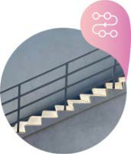
About Pink Elephant Media
Pink Elephant Media are a Digital Marketing Agency based in the UK.
We believe the most important thing any digital marketing agency can do is practice what they preach. If we recommend it it’s because we have implemented, tried it and seen results not only for ourselves but for our clients.
At Pink Elephant Media, getting to know you and your company personally allows us to deliver targeted marketing directly to your customers, converting them into paying clients and advocates of your brand.
For a full list of our services visit www.pinkelephantmedia.co.uk. You could have more for less than the monthly price of a member of staff!
At Pink Elephant Media we are:
ROI Focused
Roll over focused on long term ROI by bringing quality not just quantity
Customer Obsession
CX, DCX, UX whatever you call it we know it like the back of our hand
Business Thinking
We will keep your company goals and strive for constant growth in the forefront of our mind
Process Gurus
At peace with processes we live and breath them
Sustainable Growth
Start looking forward to growth that gets easier every day
Idea to Action
We do it for you, from idea to exe- cution we will hole your hand from beginning to end

Slide 53
info@pinkelephantmedia.co.uk
Monday - Friday: 9:30am - 5:00pm
Stroud: (01453) 705 097
Bristol: (01174) 506 691
London: (02039) 947 628
Company Number: 11974626

