Slide 2
Thanks for downloading this resource!
How to use this template:
Included in this resource are a number of different customer journey maps, including:
Buyer’s Journey Template
Current State Template
Lead Nurturing Mapping Template
Future State Template
Customer After sales to prevent churn
Customer Support Blueprint Template
[Prompts in Brackets]: These are intended for you to erase and fill in with information for your specific project, such as project name or a due date.
Once you’re ready to begin, delete the first three slides and start filling out your info below. Remember, you can add/edit/delete any wording or sections you see fit for your projects.
Lets get started >

Slide 3
Creating a Customer Journey Map
What to learn more? Pink Elephant Media training platform is designed to help our clients get the most out of their websites.
Completing this lesson will help you:
Better understand your customers
Improve your customer experience

Slide 4
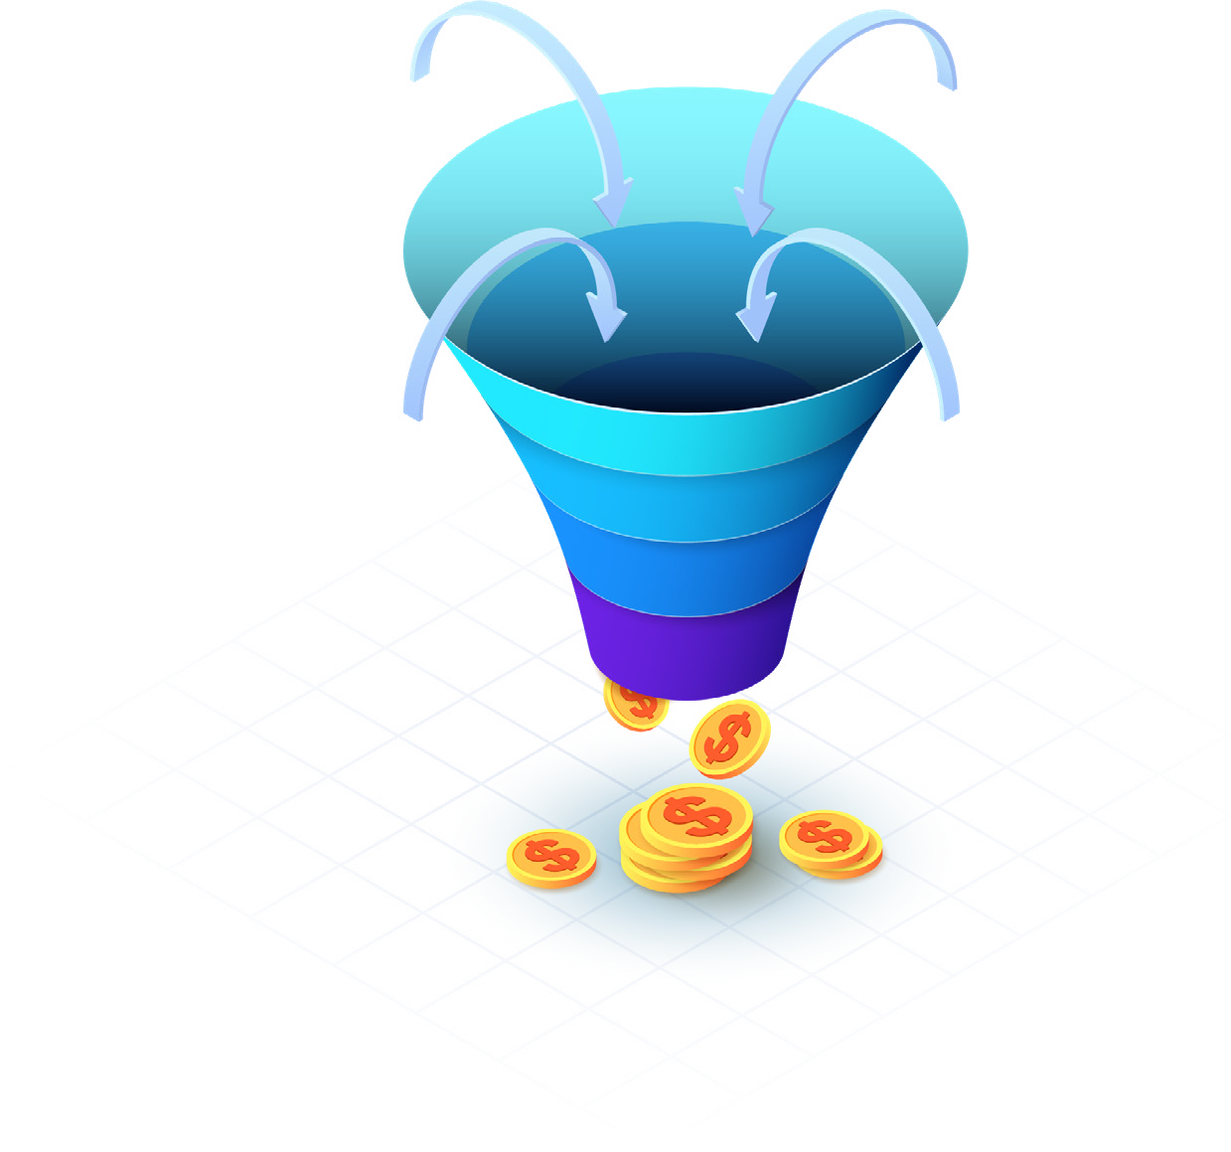
Understanding how to build sales funnels
A sales funnel is the step that a potential customer will make before becoming one. Understanding the way your customer reacts will allow us to understand what optimisation is required at each step. The first step, is to take a product or a service you offer and think about the message. Below are some key stages on
what a client is looking for. Remember good competitor research is required here. If you don’t stand out from the herd how can you compete?
What are you offering? Why should they care? What proof can you offer?
How can you relay their fears?
Remember: Your potential client does not care about you. They care about what they get when they use your product or service.

Slide 5
Conversion Funnel
Here is an example of a conversion tunnel. This should have actions tied to each stage
Awareness
Subscribers
Offer
Leads
Information
Consideration
Qualified
Free Trial
Customer
Decision
Free Trial

Slide 6
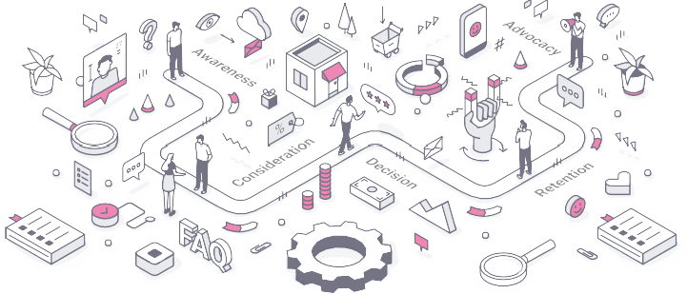
Conversion steps a prospect takes in becoming a customer
1 Discovery
How will the prospect learn about you? e.g. PPC,
LinkedIn Marketing, Social Media, Marketing.
2 Engagement
What resources can be utilised to prove to a
client you understand their need and build trust.
e.g. downloads and articles
3 Connect
Prospect given ways in which to connect.
e.g. Follow on social media and sign up to free trail
Remember: It is important when deciding upon the steps that prospects will enter the funnel at different stages and will convert at different times.
However, understanding the prospects journey will ensure that the key stages are optimised. This will allow you to check:
What part of the funnel is failing or working well
What the landing page requirements will be
What part of the funnel requires further optimisation
4 Sale
After finding value in the offer given at the
connect stage in the funnel, they become a paying customer

Slide 7
Funnel Stage
eCommerce
Other
Your Business
Email Marketing Social media
Click through rates Clicks of ads Affiliate Marketing SEO
Unique Page Visits Pages per visit Bounce Rate
Time Spent on website
Social Media Shares Downloads
Click through rate Subscriptions Downloads
Sign up to newsletter or blog
Top of the funnel
Return visits to website Number of pages viewed Reading Product Reviews
Visits to pricing page Downloads on ebooks Case Studies read Number of pages viewed
Return visitor rate Pages per visit
Time spent on the website Bounce rate
Top to Mid of the funnel
Offers Promotions Wishlists
Customer service enquiries
Requesting more details Phone call
Product demo Free trial
Completed lead forms Calls
Take up of offer
Lower mid of the funnel
Average order value No of transactions No of purchases
Lifetime value of client
Bottom of the funnel
First time purchase Repeat purchase
Purchase Signup

Slide 8
Funnel Stage
Customer Mindset
Customer Action
Success Metric
Unique Page Visits Pages per visit Bounce Rate
Time Spent on website Social Media Shares Downloads
Discovering your brand Conducting their own research
Collecting information
Top of the funnel
What do you do?
Conducting indepth research Cost analysis
Comeptitor Research
Return visitor rate Pages per visit
Time spent on the website Bounce rate
Top to Mid of the funnel
Why should I care?
Lower mid of the funnel
Requesting more details Phone call
Product demo / Free trial
Completed lead forms Calls
Take up of offer
Why should I believe you?
Average order value No of transactions No of purchases
Lifetime value of client
Bottom of the funnel
Purchase Signup
Where do we begin?

Slide 9
Awareness Stage
Customer Journey: Buy- er’s Journey
Consideration Stage
Decision Stage
What is the customer thinking or feeling?
[Your info here]
[Your info here]
[Your info here]
What is the customer’s action?
[Your info here]
[Your info here]
[Your info here]
What or where is the buyer researching?
[Your info here]
[Your info here]
[Your info here]
How will we move the buyer along his or her journey with us in mind?
[Your info here]
[Your info here]
[Your info here]

Slide 10
Customer Journey: Cur- rent State
Stage 1 | Stage 2 | Stage 3 | Stage 4 | Stage 5
[Your info | [Your info | [Your info | [Your info | [Your info
here] | here] | here] | here] | here]
[Your info | [Your info | [Your info | [Your info | [Your info
here] | here] | here] | here] | here]
What is the customer think- ing or feeling?
What is the customer’s action?
What is the customer’s touchpoint with the busi- ness?
[Your info here]
[Your info here]
[Your info here]
[Your info here]
[Your info here]
What do we want to change about this step?
[Your info here]
[Your info here]
[Your info here]
[Your info here]
[Your info here]
How and/or why will we make this change?
[Your info here]
[Your info here]
[Your info here]
[Your info here]
[Your info here]

Slide 11
Customer Journey: Lead Nuturing
Stranger
Subscriber / Lead
MQL
Oppertunity / Demo
Deal Closed to Go Live
What is the customer thinking or feeling?
[Your info here]
[Your info here]
[Your info here]
[Your info here]
[Your info here]
Who from our company is the lead hearing from or talking to?
[Your info here]
[Your info here]
[Your info here]
[Your info here]
[Your info here]
What content from our company is the lead interacting with?
[Your info here]
[Your info here]
[Your info here]
[Your info here]
[Your info here]
What can we do to expe- dite this process?
[Your info here]
[Your info here]
[Your info here]
[Your info here]
[Your info here]
What can we do to make the lead more comforta- ble in
decision making?
[Your info here]
[Your info here]
[Your info here]
[Your info here]
[Your info here]

Slide 12
Customer Journey: After Sales
Popular Churn Reason #1
Popular Churn Reason #2
Popular Churn Reason #3
Popular Churn Reason #4
Popular Churn Reason #5
What did the customer experience?
[Your info here]
[Your info here]
[Your info here]
[Your info here]
[Your info here]
What is the customer feeling after this/these incidents?
[Your info here]
[Your info here]
[Your info here]
[Your info here]
[Your info here]
Why does this ultimately cause the customer to churn?
[Your info here]
[Your info here]
[Your info here]
[Your info here]
[Your info here]
How can we improve this experience to reduce churn?
[Your info here]
[Your info here]
[Your info here]
[Your info here]
[Your info here]

Slide 13
Customer Journey: Cus- tomer Churn
Popular Churn Reason #1
Popular Churn Reason #2
Popular Churn Reason #3
Popular Churn Reason #4
Popular Churn Reason #5
What did the customer experience?
[Your info here]
[Your info here]
[Your info here]
[Your info here]
[Your info here]
What is the customer feeling after this/these incidents?
[Your info here]
[Your info here]
[Your info here]
[Your info here]
[Your info here]
Why does this ultimately cause the customer to churn?
[Your info here]
[Your info here]
[Your info here]
[Your info here]
[Your info here]
How can we improve this experience to reduce churn?
[Your info here]
[Your info here]
[Your info here]
[Your info here]
[Your info here]

Slide 14
COMPANY GOALS
This is an example. Please delete the content and make it you own.
DECISION DELIVERY & USE
STAGE
AWARENESS
CONSIDERATION
LOYALTY & ADVOCACY
CUSTOMER ACTIVITIES
[Text goes here]
[Text goes here]
[Text goes here]
[Text goes here]
[Text goes here]
[Text goes here]
[Text goes here]
[Text goes here]
[Text goes here]
CUSTOMER GOALS
[Text goes here]
[Text goes here]
[Text goes here]
[Text goes here]
[Text goes here]
[Text goes here]
[Text goes here]
[Text goes here]
[Text goes here]
POINTS OF FRICTION
What can we do to reduce the friction?
[Text goes here]
[Text goes here]
[Text goes here]
[Text goes here]
[Text goes here]
[Text goes here]
[Text goes here]
[Text goes here]
[Text goes here]
TOUCHPOINTS
[Text goes here]
[Text goes here]
[Text goes here]
[Text goes here]
[Text goes here]
[Text goes here]
[Text goes here]
[Text goes here]
[Text goes here]
BUSINESS GOAL
[Text goes here]
[Text goes here]
[Text goes here]
[Text goes here]
[Text goes here]
[Text goes here]
[Text goes here]
[Text goes here]
[Text goes here]
KPIs
[Text goes here]
[Text goes here]
[Text goes here]
[Text goes here]
[Text goes here]
[Text goes here]
[Text goes here]
[Text goes here]
[Text goes here]
ORGANISATIONAL ACTIVITIES
[Text goes here]
[Text goes here]
[Text goes here]
[Text goes here]
[Text goes here]
[Text goes here]
[Text goes here]
[Text goes here]
[Text goes here]
RESPONSIBLE
[Text goes here]
[Text goes here]
[Text goes here]
[Text goes here]
[Text goes here]
[Text goes here]
[Text goes here]
[Text goes here]
[Text goes here]
TECHNOLOGY SYSTEMS
[Text goes here]
[Text goes here]
[Text goes here]
[Text goes here]
[Text goes here]
[Text goes here]
[Text goes here]
[Text goes here]
[Text goes here]

